Slide 1

Goodreads An Heuristic Evaluation
2022/2023
Presentation by:
Gabriel Teixeira, 107876
Joana Gomes, 104429
Lia Cardoso, 107548
Licenciatura em Engenharia Informática
Class P6 Human-Computer Interaction
Professor Samuel Silva

Slide 2
About Goodreads
What is it?
Social media-like platform to discover, track and review books
What’s its target audience?
Readers and authors from around the globe
01

Slide 3
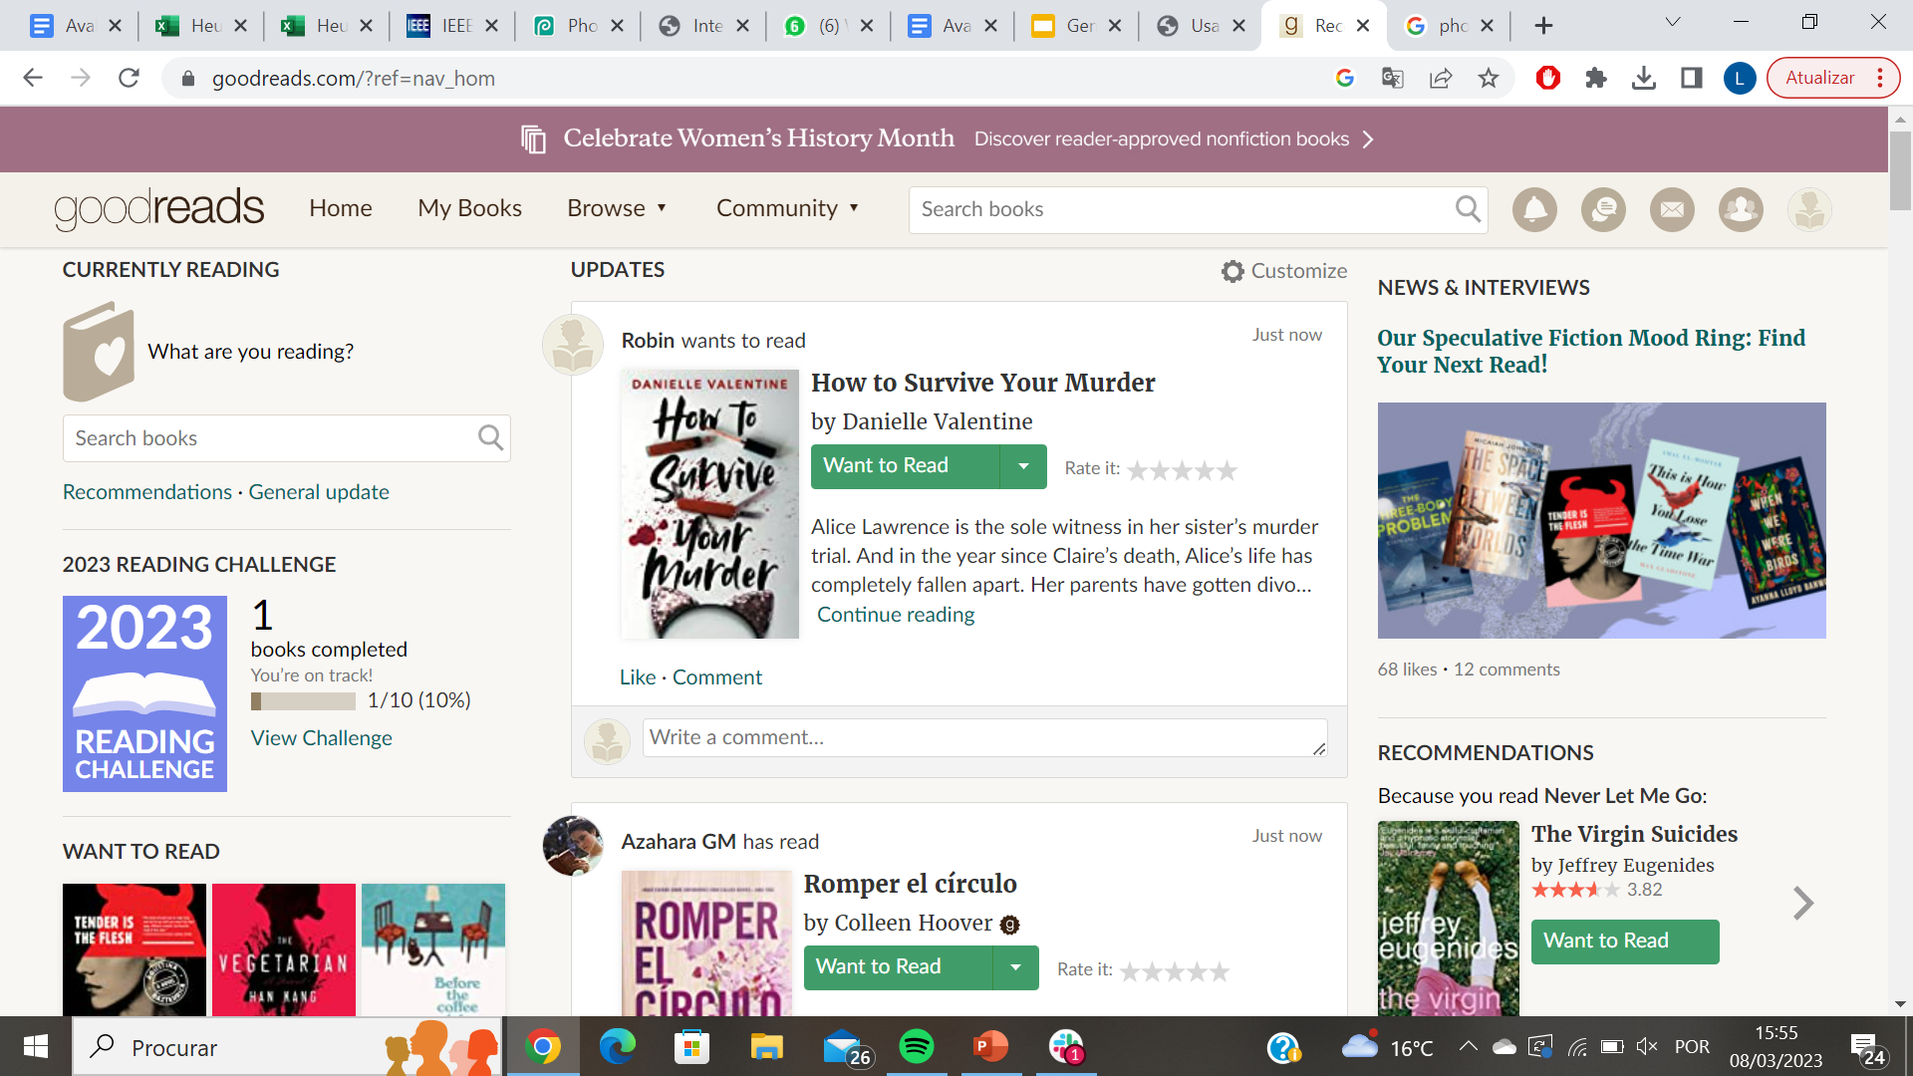
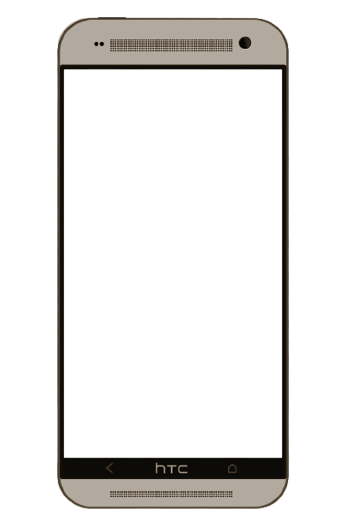
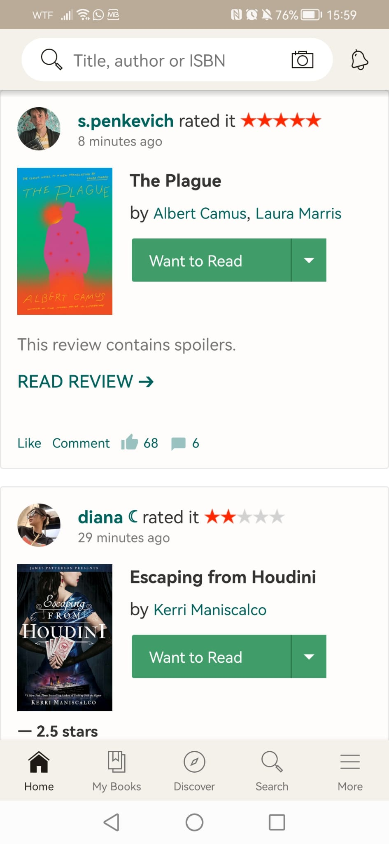
Available Platforms
Website
App
02

Slide 4
Main Actions Users Can Perform
01.
02.
Add books
Review
Users can add books that interest them to their bookshelves
Users can review books and comment/give their opinion about them
03.
04.
05.
Recommendations
Authors
Find New Friends
Users can get recommendations of books to read in the future based on their taste
Users can follow, share quotes and even have contact with their favourite authors
Users can find new people that enjoy the same books, genres and authors as them
03

Slide 5
02
Usability Evaluation
Heuristic Evaluation
Cognitive Walkthrough
04

Slide 6
Heuristic Evaluation
10 general usability heuristics
Severity Scale
Proposed by Jakob Nielsen
0 | No usability problem
1 | Cosmetic Problem
2 | Minor usability problem
3 | Major usability problem
4 | Usability disaster
05

Slide 7
 | Evaluator 1 | Evaluator 2 | Evaluator 3 | Final rating | Violated heuristics
No coherence between the design in different pages of the website | 1 | 2 | 2 | 2 | H4
Buttons are barely visible and hard to press | 3 | 4 | 3 | 3 | H5, H6, H8
The feed’s default is "People I follow", so users that don’t follow anyone have an empty feed. | 2 | 2 | 1 | 2 | H1
Editing/Personalizing text is done with HTML marks | 3 | 3 | 3 | 3 | H2, H7
06

Slide 8
 | Evaluator 1 | Evaluator 2 | Evaluator 3 | Final rating | Violated heuristics
No coherence between design in different OS. | 1 | 2 | 2 | 2 | H4, H6, H8
Too much information on the Home page. | 2 | 3 | 2 | 2 | H7
The color palette of the website isn’t very appealing. | 0 | 1 | 1 | 1 | H1, H8
Not divided by pages and no "go back to top" button (infinite scroll) | 3 | 3 | 3 | 3 | H7, H8
07

Slide 9
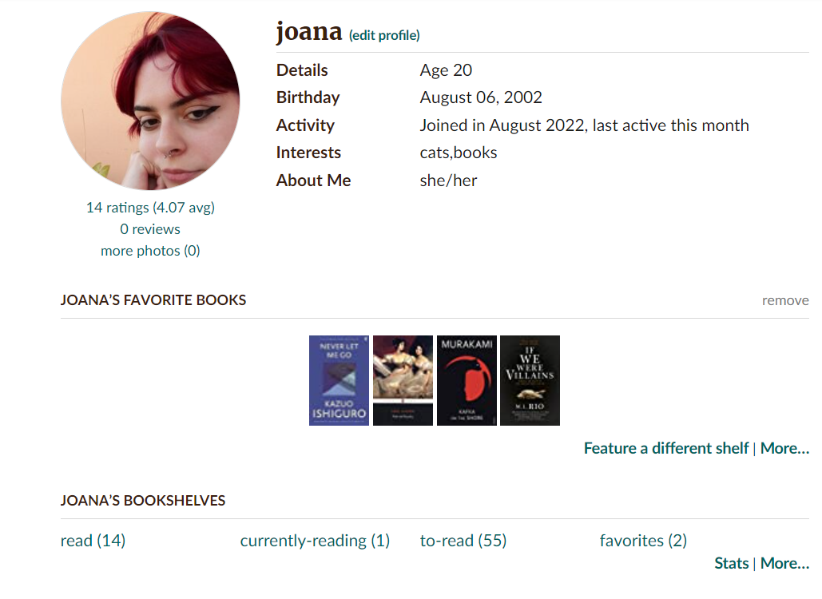
Problem 1: Buttons are barely visible and hard to press
H5: Error prevention
H6: Recognition rather than recall
H8: Aesthetic and minimalist design

Slide 10
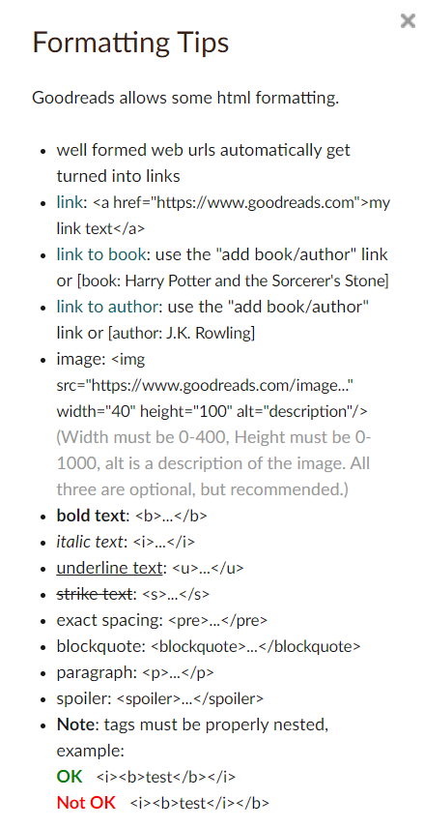
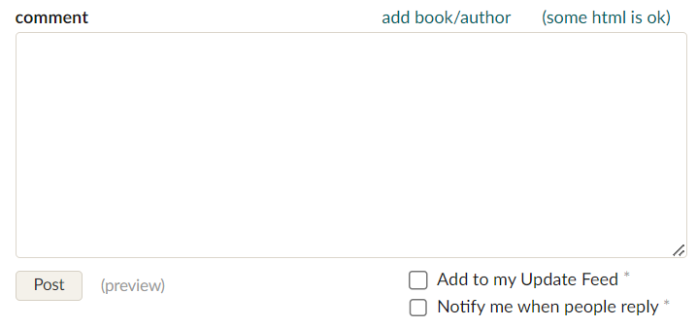

Problem 2: Editing/Personalizing text is done with HTML marks
H2: Match between system and the real world
H7: Flexibility and efficiency of use

Slide 11
Problem 3: Not divided by pages and no "go back to top" button
H7: Flexibility and efficiency of use
H8: Aesthetic and minimalist design

Slide 12
03
Cognitive Walkthrough
Selection of 2 tasks for users to perform and their analysis

Slide 13
Cognitive Walkthrough Tasks
01. Adding a book to a personalized bookshelf
02. Search for list of books written by portuguese authors

Slide 14
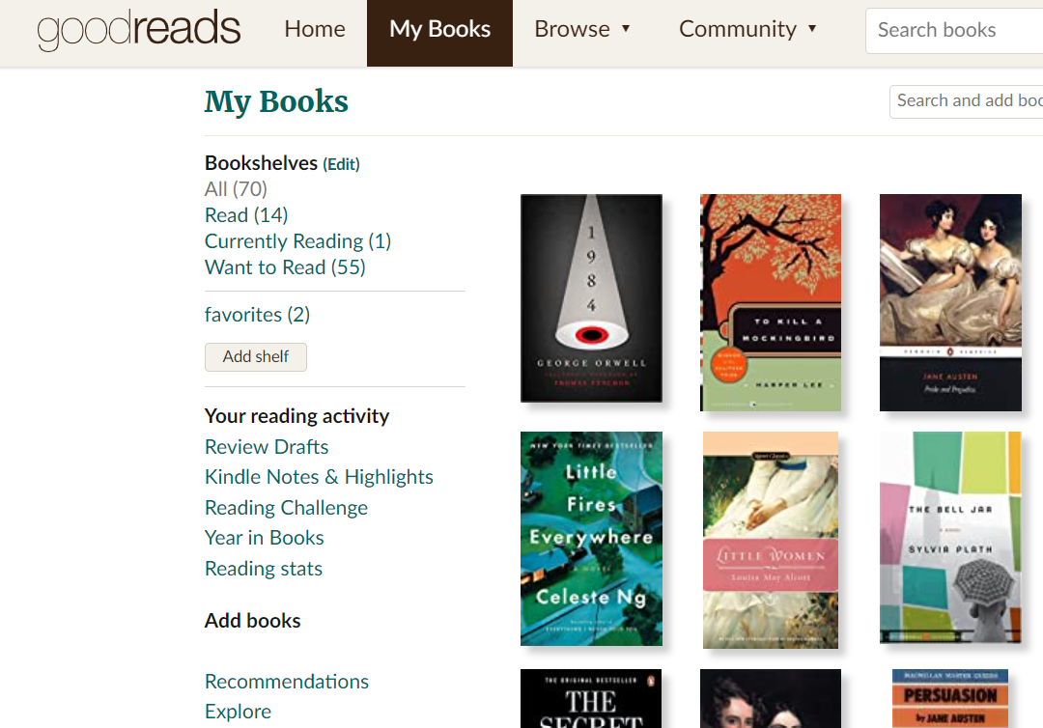
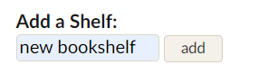
First Step: Create a personalized bookshelf
1
2

Slide 15
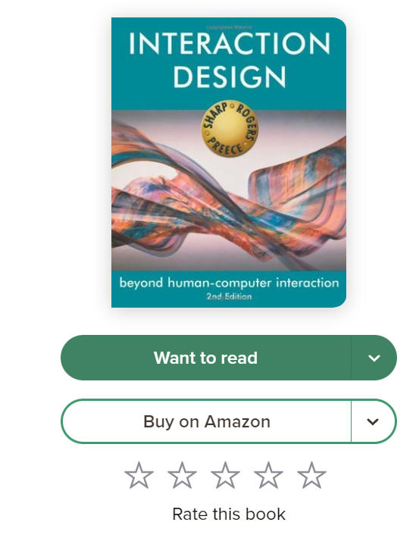
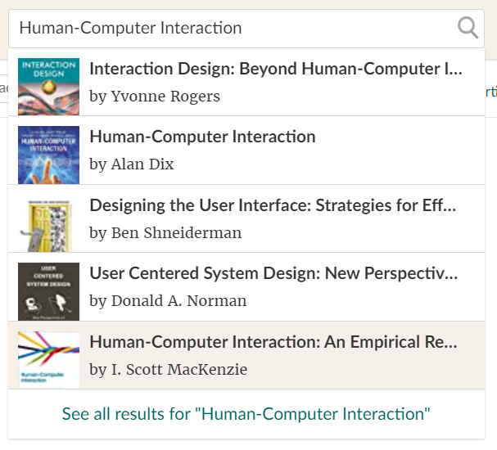
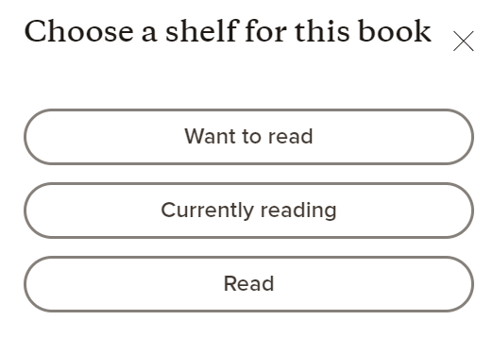
Second Step: Choose book to add
3
5
4
4

Slide 16
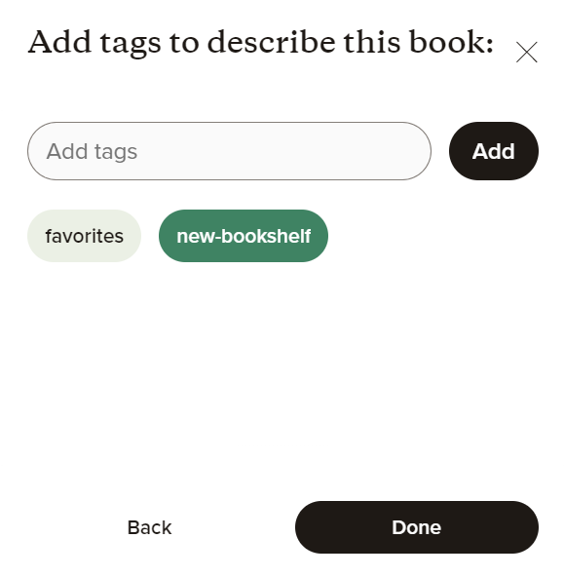
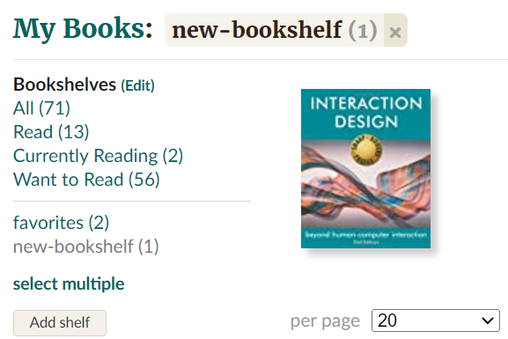
Third Step: Add book to personalised bookshelf
6
7

Slide 17
Cognitive Walkthrough Tasks
01. Adding a book to a personalized bookshelf
02. Search for list of books written by portuguese authors

Slide 18
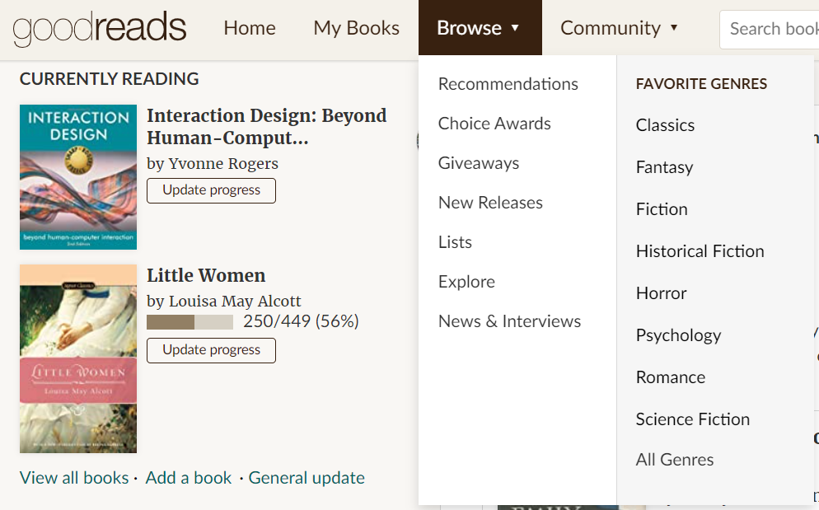
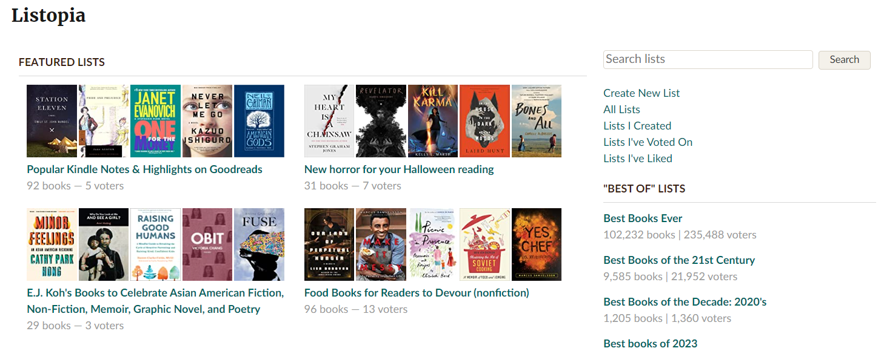
First Step: Go to lists
2
1

Slide 19
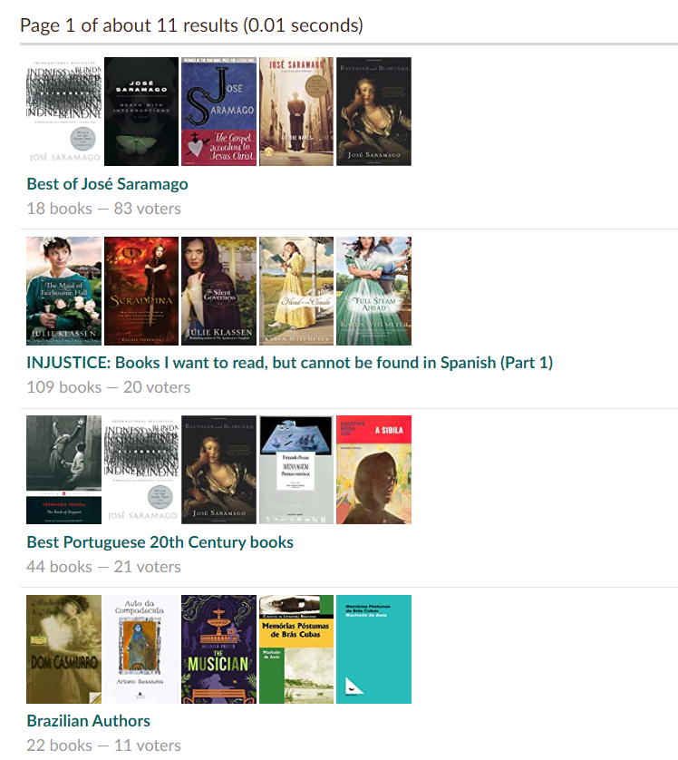
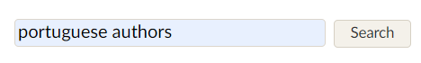
Second Step: Search for list of portuguese authors
3
4

Slide 20
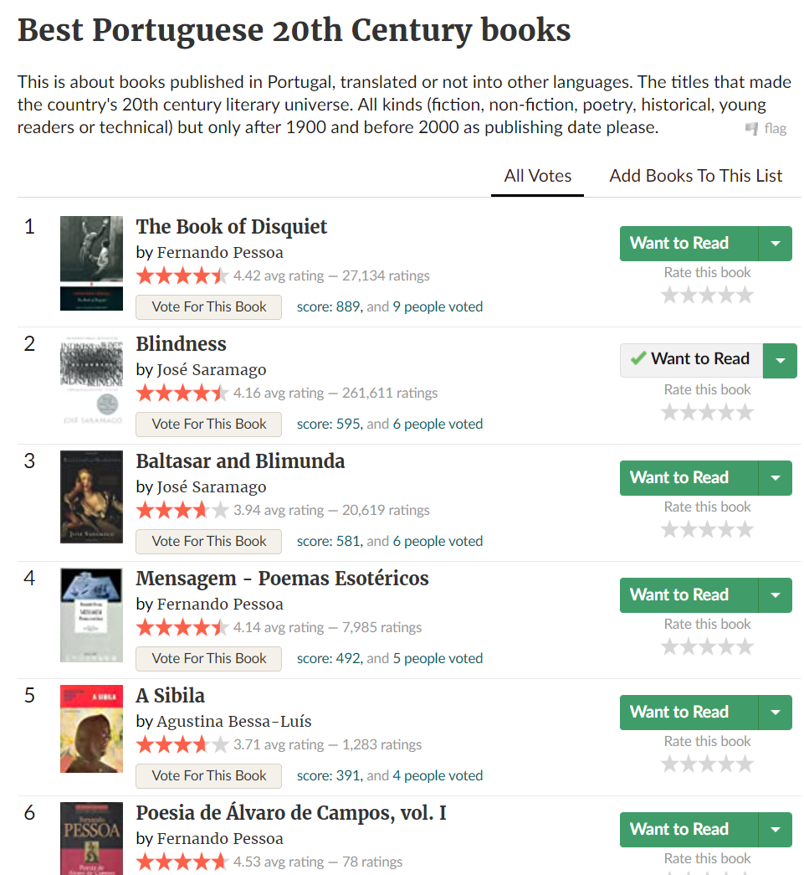
5
Third Step: Look for desired book(s)

Slide 21
Conclusions
Although Goodreads is a very popular platform it still shows a great number of usability issues
Most of the problems found could be fixed ,simply, by creating a simpler and more user-friendly design
Goodreads can get lost beetwen its competitors, who offer a basic UX Design and the same main functions as itself
04

Slide 22
Bibliography
05
https://www.goodreads.com/
https://www.nngroup.com/articles/how-to-conduct-a-heuristic-evaluation/
https://www.nngroup.com/articles/ten-usability-heuristics/
https://www.nngroup.com/articles/cognitive-walkthroughs/

